Slide 1
各式各樣的 Attention
Hung-yi Lee 李宏毅
Notes:
TBD:
-- Routing Transformer : Does clustering jointly learned
-- check Sinkhorn normalization
-- Big Bird: random attention
-- What do performer series really learn
-- Pay Attention to MLPs? How it does?
-- What is the dime of kernel mathods??? done
-- sinhorn v.s. synthesizer
-- LRA done
Probably Ignore:
-- XL transofmer
-- Perceiver?
-- Axial Transformer (Ho et al., 2019) applies a sequence of self-attention computations given a high dimensional tensor as input, each along a single axis of the input tensor.
用人工
用學的
加速簡化
奇招
TBD:
Fix pattern
Hash
Low rank approximation
Other new stuff

Slide 2


Prerequisite
https://youtu.be/hYdO9CscNes
https://youtu.be/gmsMY5kc-zw
【機器學習2021】自注意力機制 (Self-attention) (上)
【機器學習2021】自注意力機制 (Self-attention) (下)

Slide 3
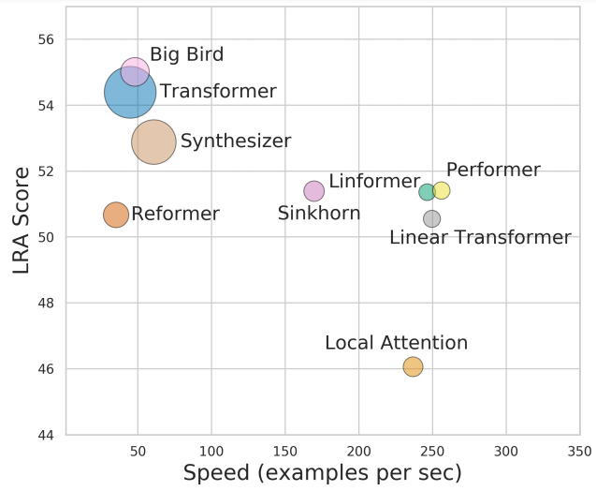
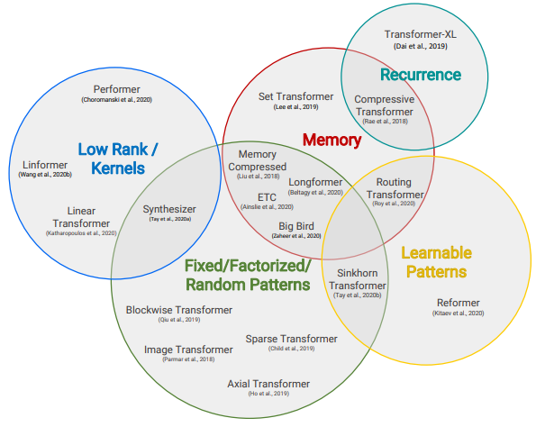
To Learn More …
Long Range Arena: A Benchmark for Efficient Transformers
https://arxiv.org/abs/2011.04006
Efficient Transformers: A Survey
https://arxiv.org/abs/2009.06732
Notes:
Arena 競技場

Slide 4


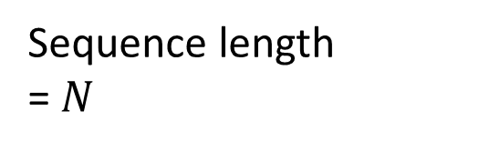

How to make self-attention efficient?
key
Sequence length
= $N$
$$N$$
$$N$$
query
Attention Matrix
$$N×N$$

Slide 5
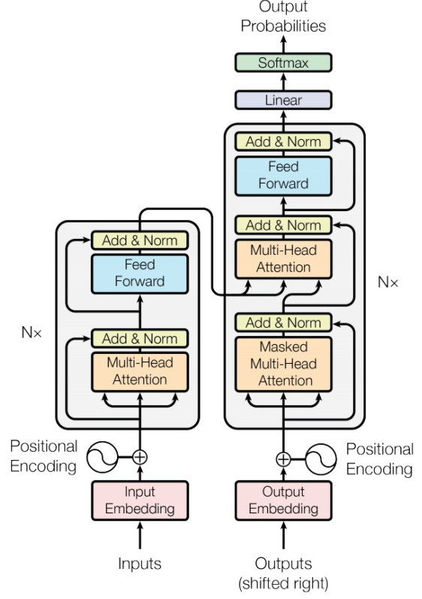
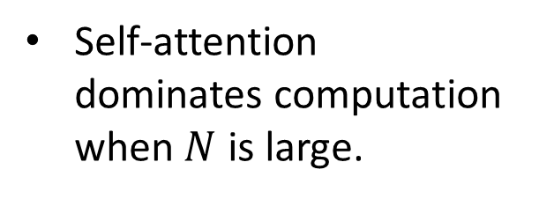


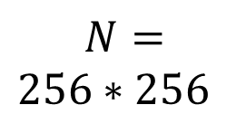
Notice
Self-attention is only a module in a larger network.
Self-attention dominates computation when $N$ is large.
Usually developed for image processing
$$N=$$
$256∗256$
$$256$$
$$256$$

Slide 6
Skip Some Calculations with Human Knowledge
Can we fill in some values with human knowledge?
Notes:
Examples of models that do this include Blockwise (Qiu et al., 2019) and/or Local Attention (Parmar et al., 2018).

Slide 7
Local Attention / Truncated Attention
Set to 0
……
query
Similar with CNN
Calculate attention weight
key
Notes:
Examples of models that do this include Blockwise (Qiu et al., 2019) and/or Local Attention (Parmar et al., 2018).

Slide 8
Stride Attention
…
…
Notes:
Strided Patterns
Models such as Sparse Transformer (Child et al., 2019) and/or Longformer (Beltagy et al., 2020) employ strided or “dilated” windows.

Slide 9
Global Attention
special token = “token中的里長伯“
Add special token into original sequence
Attend to every token $→$ collect global information
Attended by every token $→$ it knows global information
…
No attention between non-special token
…
Notes:
- Another prominent method is to leverage a side memory module that can access multiple tokens at once.
Global memory is also used in ETC (Ainslie et al., 2020) and Longformer (Beltagy et al., 2020).

Slide 10
Many Different Choices …
小孩子才做選擇．．．
Different heads use different patterns.
Notes:
Combination of Patterns
The key idea of combined1 approaches is to improve coverage by combining two or more distinct access patterns. For example, the Sparse Transformer (Child et al., 2019) combines strided and local attention by assigning half of its heads to pattern

Slide 11
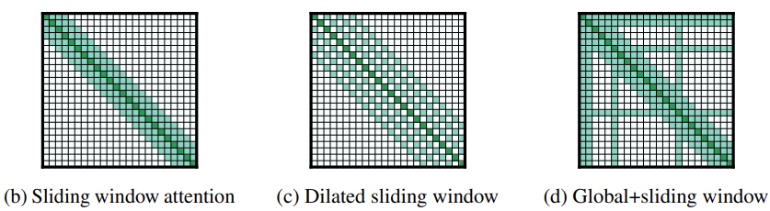
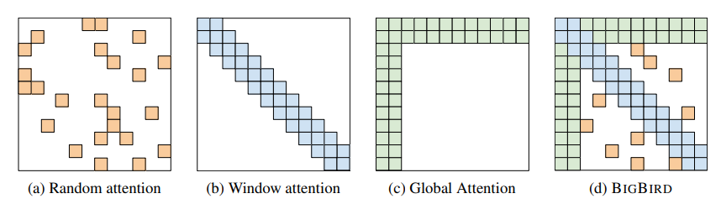
Many Different Choices …
Longformer
Big Bird
https://arxiv.org/abs/2004.05150
https://arxiv.org/abs/2007.14062
Notes:
Sparse
Block Transformer
The key idea of combined1 approaches is to improve coverage by combining two or more distinct access patterns. For example, the Sparse Transformer (Child et al., 2019) combines strided and local attention by assigning half of its heads to pattern

Slide 12
Can we only focus on Critical Parts?
key
small value
Directly set to 0
query
Smaller influence on results
large value
How to quickly estimate the portion with small attention weights?

Slide 13
Clustering
Reformer
https://openreview.net/forum?id=rkgNKkHtvB
Routing Transformer
https://arxiv.org/abs/2003.05997
Step 1
query
key
Clustering
based on similarity
(approximate & fast)
1
4
1
2
3
3
3
2
2
1
3
3
1
4
1
4
Notes:
Reformer (Kitaev et al., 2020) introduces a hash-based similarity measure to efficiently cluster tokens into chunks.
Routing Transformer (Roy et al., 2020) employs online k-means clustering on the tokens.

Slide 14
Clustering
key
Step 2
query
Belong to the same cluster, then calculate attention weight
Not the same cluster, set to 0
Notes:
Our strategy first assigns queries and keys to clusters. Then only queries and keys from the same cluster are considered for attention.
In other words, the current time-step query is routed to a limited number of context elements through its cluster assignment.
===
Reformer (Kitaev et al., 2020) introduces a hash-based similarity measure to efficiently cluster tokens into chunks.
Routing Transformer (Roy et al., 2020) employs online k-means clustering on the tokens.

Slide 15
Learnable Patterns
https://arxiv.org/abs/2002.11296
Input sequence
Sinkhorn Sorting Network
key
NN
Jointly learned
query
A grid should be skipped or not is decided by another learned module
(simplified version)
Notes:
Sinkhorn Sorting Network (Tay et al., 2020b) exposes the sparsity in attention weights by learning to to sort blocks of the input sequence
instead of attending to tokens in the same block, each token attends to tokens in the newly sorted block,

Slide 16
Do we need full attention matrix?
Linformer
https://arxiv.org/abs/2006.04768
Many redundant columns
query
key
Low Rank
Notes:
Another emerging technique is to improve efficiency by leveraging low-rank approximations of the self-attention matrix
The usage of kernels (Katharopoulos et al., 2020; Choromanski et al., 2020) enable clever mathematical re-writing of the self-attention mechanism to avoid explicitly computing the N × N matrix.
=====
self-attention is low rank:
The right figure plots the heatmap of normalized cumulative eigenvalue at the 128-th largest eigenvalue across different layers and heads in Wiki103 data. (n=512)

Slide 17




$$N$$
$$N$$
value
key
Representative keys
$$K$$
$$K$$
output
Can we reduce the number of queries?
query
change output sequence length

Slide 18






Reduce Number of Keys
Compressed Attention
Linformer
https://arxiv.org/abs/1801.10198
https://arxiv.org/abs/2006.04768
$$N$$
$$d$$
Conv
Conv
Conv
Conv
$$N×K$$
$$d$$
Linear combination of $N$ vectors
$$K$$
Notes:
只有幾種ｖａｌｕｅ，只有幾種qeruy
Cannot do causula masking
Funnel (漏斗) transformer -> signore this

Slide 19



















Attention Mechanism is three-matrix Multiplication
Review
$$Q$$
$$d×N$$
=
$$I$$
$$W^{q}$$
$$d×N$$
$$K$$
=
$$I$$
$$W^{k}$$
$$d′×N$$
$$V$$
=
$$I$$
$$W^{v}$$
$$A′$$
$$A$$
=
$$Q$$
$$K^{T}$$
softmax
ignore
$$A′$$
$$O$$
=
$$V$$

Slide 20







Attention Mechanism is three-matrix Multiplication
Review
$$Q$$
$$d×N$$
=
$$I$$
$$W^{q}$$
$$d×N$$
$$K$$
=
$$I$$
$$W^{k}$$
$$d′×N$$
$$V$$
=
$$I$$
$$W^{v}$$
$$O$$
$$≈$$
$$V$$
$$Q$$
$$K^{T}$$
$$d′×N$$
$$d′×N$$
$$d×N$$
$$N×d$$

Slide 21
















$$O$$
$$≈$$
$$V$$
$$Q$$
$$K^{T}$$
$$d′×N$$
$$d′×N$$
$$d×N$$
$$N×d$$
$$O$$
$$≈$$
$$V$$
$$Q$$
$$K^{T}$$
$$d′×N$$
$$d′×N$$
$$d×N$$
What is the difference?
$$N×d$$

Slide 22
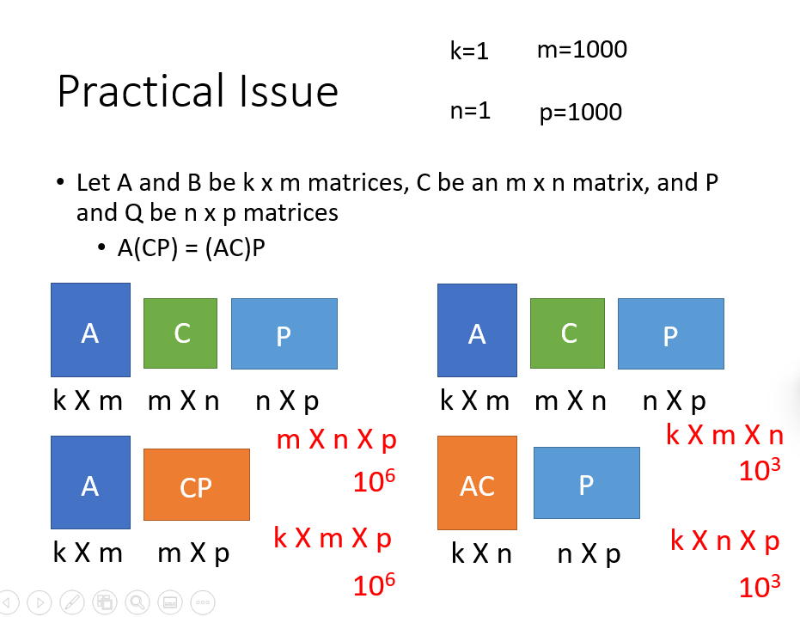
Review Linear Algebra
https://youtu.be/yO8lDzf4jMs

Slide 23







$$O$$
$$≈$$
$$V$$
$$Q$$
$$K^{T}$$
$$\left(d+d′\right)N^{2}$$
$$d′×N$$
$$d′×N$$
$$d×N$$
$$N×d$$
$$N×d×N$$
$$A$$
$$V$$
Attention Matrix
$$d′×N$$
$$N×N$$
$$d′×N×N$$

Slide 24









$$O$$
$$≈$$
$$V$$
$$Q$$
$$K^{T}$$
$${2d}^{′}dN$$
$$d′×N$$
$$d′×N$$
$$d×N$$
$$N×d$$
$$d′×N×d$$
$$d×N$$
$$d′×d$$
$$?$$
$$Q$$
$$d′×d×N$$

Slide 25






$$O$$
$$≈$$
$$V$$
$$Q$$
$$K^{T}$$
$$\left(d+d′\right)N^{2}$$
$$d×N$$
$$d×N$$
$$d×N$$
$$N×d$$
$$>$$
$$O$$
$$≈$$
$$V$$
$$Q$$
$$K^{T}$$
$${2d}^{′}dN$$
$$d×N$$
$$d×N$$
$$d×N$$
$$N×d$$

Slide 26
Let’s put softmax back …
Warning of math

Slide 27













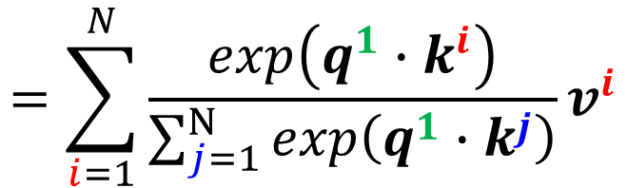





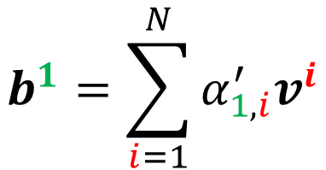
$$b^{1}=\sum_{i=1}^{N}{α_{1,i}^{′}v^{i}}$$
$$=\sum_{i=1}^{N}{\frac{exp\left(q^{1}∙k^{i}\right)}{\sum_{j=1}^{N}{exp\left(q^{1}∙k^{j}\right)}}v^{i}}$$
$$b^{1}$$
$$α_{1,1}^{′}$$
$$α_{1,2}^{′}$$
$$α_{1,3}^{′}$$
$$α_{1,4}^{′}$$
$$q^{1}$$
$$k^{1}$$
$$v^{1}$$
$$k^{2}$$
$$v^{2}$$
$$k^{3}$$
$$v^{3}$$
$$k^{4}$$
$$v^{4}$$
$$a^{1}$$
$$a^{2}$$
$$a^{3}$$
$$a^{4}$$

Slide 28

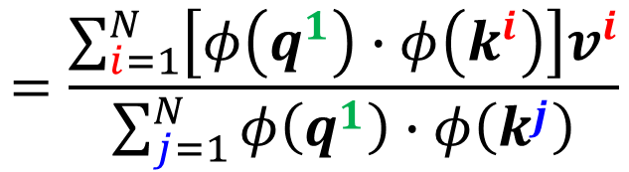

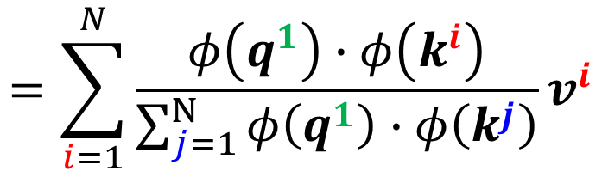




$$b^{1}=\sum_{i=1}^{N}{α_{1,i}^{′}v^{i}}$$
$$=\sum_{i=1}^{N}{\frac{exp\left(q^{1}∙k^{i}\right)}{\sum_{j=1}^{N}{exp\left(q^{1}∙k^{j}\right)}}v^{i}}$$
$$=\sum_{i=1}^{N}{\frac{φ\left(q^{1}\right)∙φ\left(k^{i}\right)}{\sum_{j=1}^{N}{φ\left(q^{1}\right)∙φ\left(k^{j}\right)}}v^{i}}$$
$$exp\left(q∙k\right)≈φ\left(q\right)∙φ\left(k\right)$$
$$q$$
$$φ$$
$$φ\left(q\right)$$
$$=\frac{\sum_{i=1}^{N}{\left[φ\left(q^{1}\right)∙φ\left(k^{i}\right)\right]v^{i}}}{\sum_{j=1}^{N}{φ\left(q^{1}\right)∙φ\left(k^{j}\right)}}$$
$$φ\left(q^{1}\right)∙\sum_{j=1}^{N}{φ\left(k^{j}\right)}$$
$$φ\left(q^{1}\right)$$

Slide 29
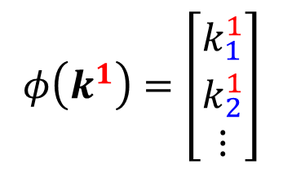
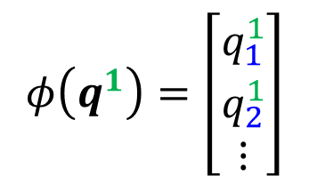

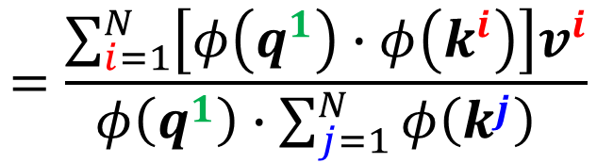
$$b^{1}=\sum_{i=1}^{N}{α_{1,i}^{′}v^{i}}$$
$$=\frac{\sum_{i=1}^{N}{\left[φ\left(q^{1}\right)∙φ\left(k^{i}\right)\right]v^{i}}}{φ\left(q^{1}\right)∙\sum_{j=1}^{N}{φ\left(k^{j}\right)} }$$
$$\sum_{i=1}^{N}{\left[φ\left(q^{1}\right)∙φ\left(k^{i}\right)\right]v^{i}}$$
$$φ\left(q^{1}\right)=\left[\begin{aligned}q_{1}^{1} \\ q_{2}^{1} \\ ⋮\end{aligned}\right]$$
$$φ\left(k^{1}\right)=\left[\begin{aligned}k_{1}^{1} \\ k_{2}^{1} \\ ⋮\end{aligned}\right]$$
$$=\left[φ\left(q^{1}\right)∙φ\left(k^{1}\right)\right]v^{1}+\left[φ\left(q^{1}\right)∙φ\left(k^{2}\right)\right]v^{2}+…$$
$$=\left(q_{1}^{1}k_{1}^{1}+q_{2}^{1}k_{2}^{1}+…\right)v^{1}+\left(q_{1}^{1}k_{1}^{2}+q_{2}^{1}k_{2}^{2}+…\right)v^{2}+…$$
$$=q_{1}^{1}k_{1}^{1}v^{1}+q_{2}^{1}k_{2}^{1}v^{1}+…+q_{1}^{1}k_{1}^{2}v^{2}+q_{2}^{1}k_{2}^{2}v^{2}+…+…$$
$$=q_{1}^{1}\left(k_{1}^{1}v^{1}+k_{1}^{2}v^{2}+…\right)+q_{2}^{1}\left(k_{2}^{1}v^{1}+k_{2}^{2}v^{2}+…\right)$$

Slide 30
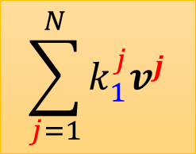

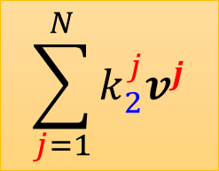
$$b^{1}=\sum_{i=1}^{N}{α_{1,i}^{′}v^{i}}$$
$$=\frac{\sum_{i=1}^{N}{\left[φ\left(q^{1}\right)∙φ\left(k^{i}\right)\right]v^{i}}}{φ\left(q^{1}\right)∙\sum_{j=1}^{N}{φ\left(k^{j}\right)} }$$
$$\sum_{i=1}^{N}{\left[φ\left(q^{1}\right)∙φ\left(k^{i}\right)\right]v^{i}}$$
$$φ\left(q^{1}\right)=\left[\begin{aligned}q_{1}^{1} \\ q_{2}^{1} \\ ⋮\end{aligned}\right]$$
$$φ\left(k^{1}\right)=\left[\begin{aligned}k_{1}^{1} \\ k_{2}^{1} \\ ⋮\end{aligned}\right]$$
M dim
$$=q_{1}^{1}\left(k_{1}^{1}v^{1}+k_{1}^{2}v^{2}+…\right)+q_{2}^{1}\left(k_{2}^{1}v^{1}+k_{2}^{2}v^{2}+…\right)$$
$$\sum_{j=1}^{N}{k_{1}^{j}v^{j}}$$
$$\sum_{j=1}^{N}{k_{2}^{j}v^{j}}$$
...
$$φ\left(q^{1}\right)$$
M vectors

Slide 31



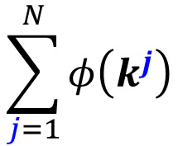

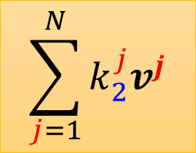








...
......
$$v^{1}$$
$$v^{2}$$
$$v^{3}$$
$$v^{N}$$
$$φ\left(k^{1}\right)$$
$$φ\left(k^{2}\right)$$
$$φ\left(k^{3}\right)$$
$$φ\left(k^{N}\right)$$
M dim
$$\sum_{j=1}^{N}{k_{1}^{j}v^{j}}$$
$$\sum_{j=1}^{N}{k_{2}^{j}v^{j}}$$
M vectors
...
$$φ\left(q^{1}\right)$$
M dim
$$b^{1}=$$
$$\sum_{j=1}^{N}{φ\left(k^{j}\right)}$$
$$φ\left(q^{1}\right)$$

Slide 32







...
$$φ\left(q^{1}\right)$$
$$b^{1}=$$
$$φ\left(q^{1}\right)$$
Don’t compute again
...
$$φ\left(q^{2}\right)$$
$$b^{2}=$$
……
$$φ\left(q^{2}\right)$$
$$b^{N}= …$$

Slide 33
Let’s put softmax back …
End of warning

Slide 34


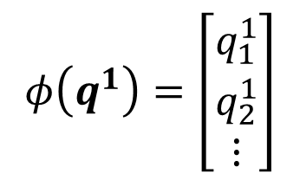











weighted sum
$$v^{1}$$
=
+
$$v^{2}$$
$$v^{3}$$
$$v^{4}$$
+
+
$$φ\left(q^{1}\right)=\left[\begin{aligned}q_{1}^{1} \\ q_{2}^{1} \\ ⋮\end{aligned}\right]$$
$$v^{1}$$
=
+
$$v^{2}$$
$$v^{3}$$
$$v^{4}$$
+
+
…
M vectors
M dimensions
$$φ\left(k^{1}\right)$$
$$φ\left(k^{2}\right)$$
$$φ\left(k^{3}\right)$$
$$φ\left(k^{4}\right)$$
$$q^{1}$$
$$k^{1}$$
$$v^{1}$$
$$k^{2}$$
$$v^{2}$$
$$k^{3}$$
$$v^{3}$$
$$k^{4}$$
$$v^{4}$$
$$a^{1}$$
$$a^{2}$$
$$a^{3}$$
$$a^{4}$$

Slide 35
weighted sum
$$v^{1}$$
=
+
$$v^{2}$$
$$v^{3}$$
$$v^{4}$$
+
+
$$φ\left(q^{1}\right)=\left[\begin{aligned}q_{1}^{1} \\ q_{2}^{1} \\ ⋮\end{aligned}\right]$$
$$v^{1}$$
=
+
$$v^{2}$$
$$v^{3}$$
$$v^{4}$$
+
+
…
M vectors
...
$$φ\left(q^{1}\right)$$
$$b^{1}=$$
$$\sum_{j=1}^{N}{φ\left(k^{j}\right)}$$
$$φ\left(q^{1}\right)$$

Slide 36



template selection
$$v^{1}$$
=
+
$$v^{2}$$
$$v^{3}$$
$$v^{4}$$
+
+
$$b^{2}=?$$
template 1
$$φ\left(q^{2}\right)$$
$$v^{1}$$
=
+
$$v^{2}$$
$$v^{3}$$
$$v^{4}$$
+
+
template 2
…
M vectors
$$φ\left(k^{1}\right)$$
$$φ\left(k^{2}\right)$$
$$φ\left(k^{3}\right)$$
$$φ\left(k^{4}\right)$$
$$q^{1}$$
$$k^{1}$$
$$v^{1}$$
$$q^{2}$$
$$k^{2}$$
$$v^{2}$$
$$k^{3}$$
$$v^{3}$$
$$k^{4}$$
$$v^{4}$$
$$a^{1}$$
$$a^{2}$$
$$a^{3}$$
$$a^{4}$$

Slide 37



Realization
Efficient attention
Linear Transformer
Random Feature Attention
Performer
https://arxiv.org/pdf/1812.01243.pdf
$$exp\left(q∙k\right)≈φ\left(q\right)∙φ\left(k\right)$$
https://linear-transformers.com/
$$q$$
$$φ$$
$$φ\left(q\right)$$
https://arxiv.org/pdf/2103.02143.pdf
https://arxiv.org/pdf/2009.14794.pdf

Slide 38







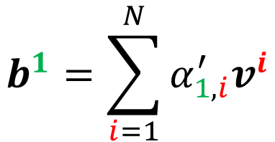


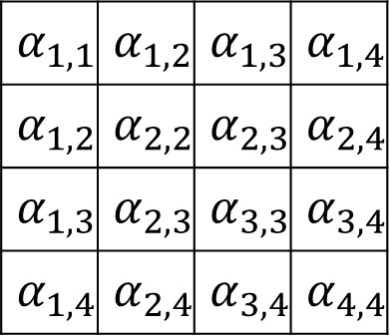



Do we need q and k to compute attention? Synthesizer!
https://arxiv.org/abs/2005.00743
$$b^{1}$$
$$b^{2}$$
$$b^{3}$$
$$b^{4}$$
$$α_{1,1}$$ | $$α_{1,2}$$ | $$α_{1,3}$$ | $$α_{1,4}$$
$$α_{1,2}$$ | $$α_{2,2}$$ | $$α_{2,3}$$ | $$α_{2,4}$$
$$α_{1,3}$$ | $$α_{2,3}$$ | $$α_{3,3}$$ | $$α_{3,4}$$
$$α_{1,4}$$ | $$α_{2,4}$$ | $$α_{3,4}$$ | $$α_{4,4}$$
softmax
$$b^{1}=\sum_{i=1}^{N}{α_{1,i}^{′}v^{i}}$$
From q and k?
$$v^{1}$$
$$v^{2}$$
$$v^{3}$$
$$v^{4}$$
They are network parameters!
$$a^{1}$$
$$a^{2}$$
$$a^{3}$$
$$a^{4}$$

Slide 39
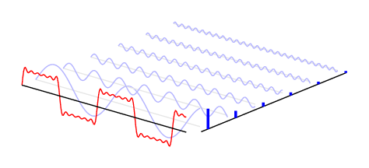
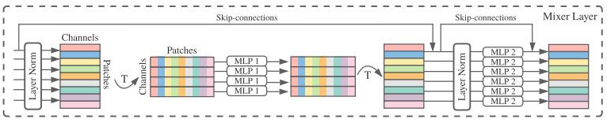
Attention-free?
Fnet: Mixing tokens with fourier transforms
Pay Attention to MLPs
MLP-Mixer: An all-MLP Architecture for Vision
https://arxiv.org/abs/2105.03824
https://arxiv.org/abs/2105.08050
https://arxiv.org/abs/2105.01601
Notes:
ViT2Vit -> CNN
Beyond Self-attention: External Attention using Two Linear Layers for Visual Tasks

Slide 40
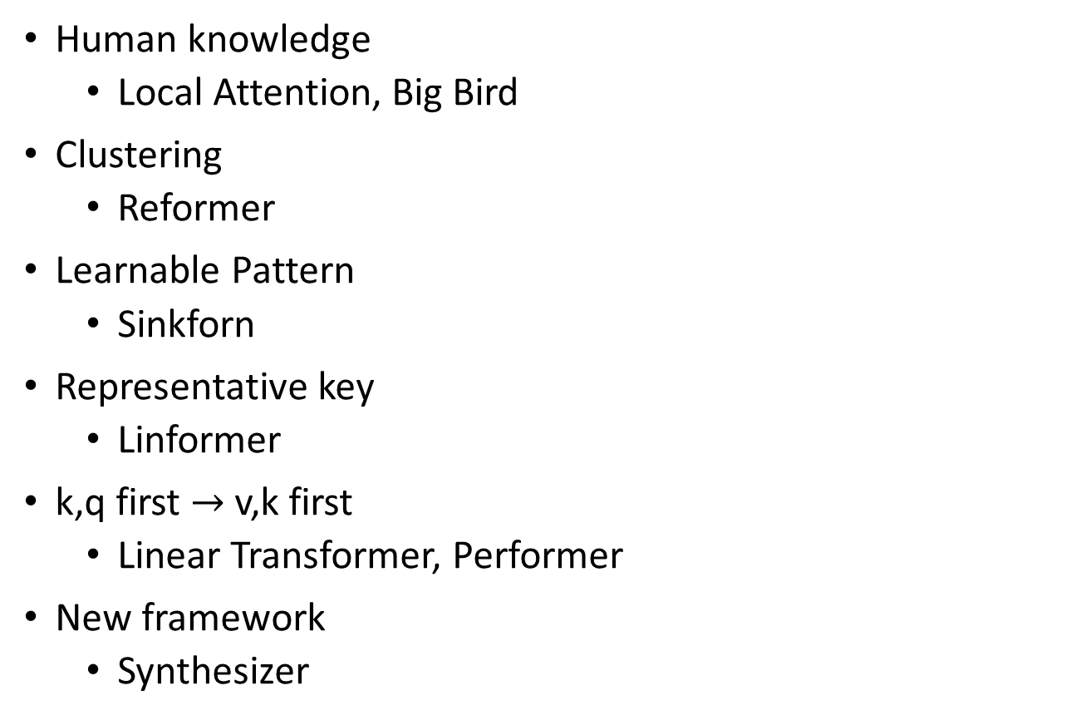
Summary
Human knowledge
Local Attention, Big Bird
Clustering
Reformer
Learnable Pattern
Sinkforn
Representative key
Linformer
k,q first $→$ v,k first
Linear Transformer, Performer
New framework
Synthesizer

